Slide 1
Westmorland
Power Interruptions
September 4, 2024
Matt Smelser
Power Manager

Slide 2
Outage Update (April- July)
For the period from April to July, Westmorland experienced six outages, four of which were momentary. Causes included Mylar balloons and equipment failure.
The longest recorded outage occurred on April 20th. Lasting around 3 hours and impacting 52 customers.
Westmorland did not experienced loss of power supply to the substation for this period.

Slide 3
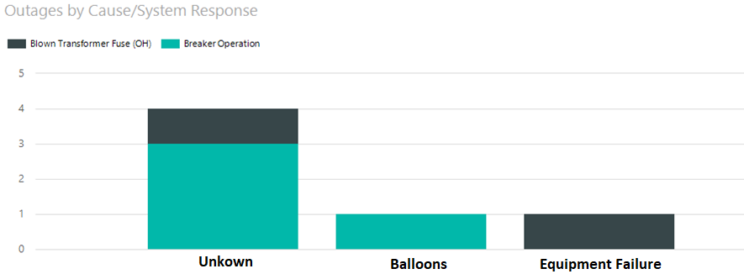
(April-July) Outages Westmorland
Note: Four were breaker reclose operations less than a minute.

Slide 4
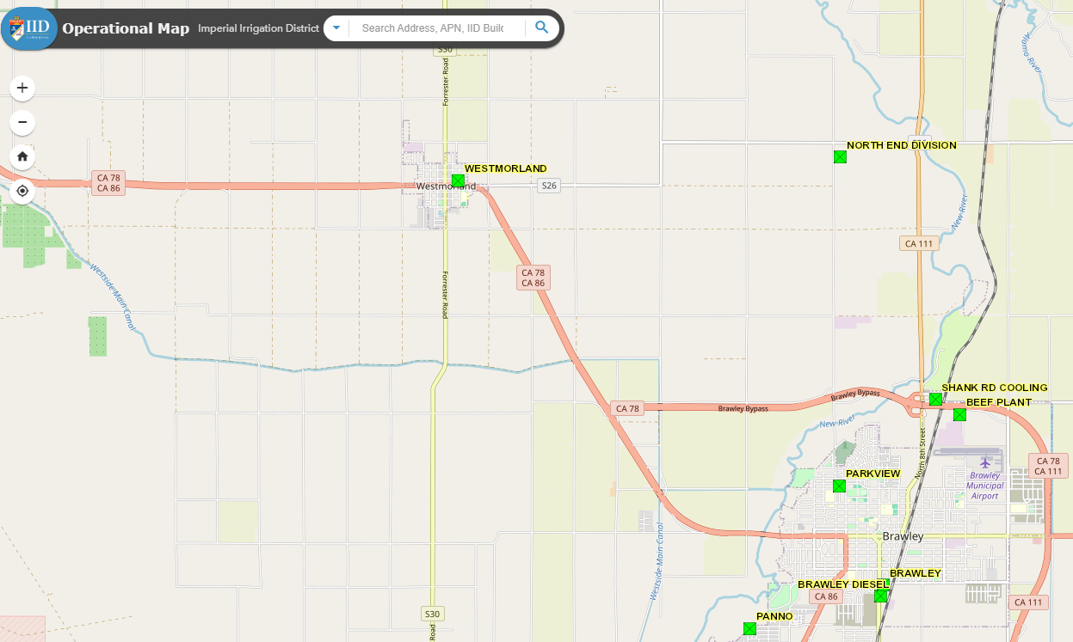
Hot Backup Feed
Current Feed
RW-Line
BP-Line
New
Hot Backup Feed

Slide 5
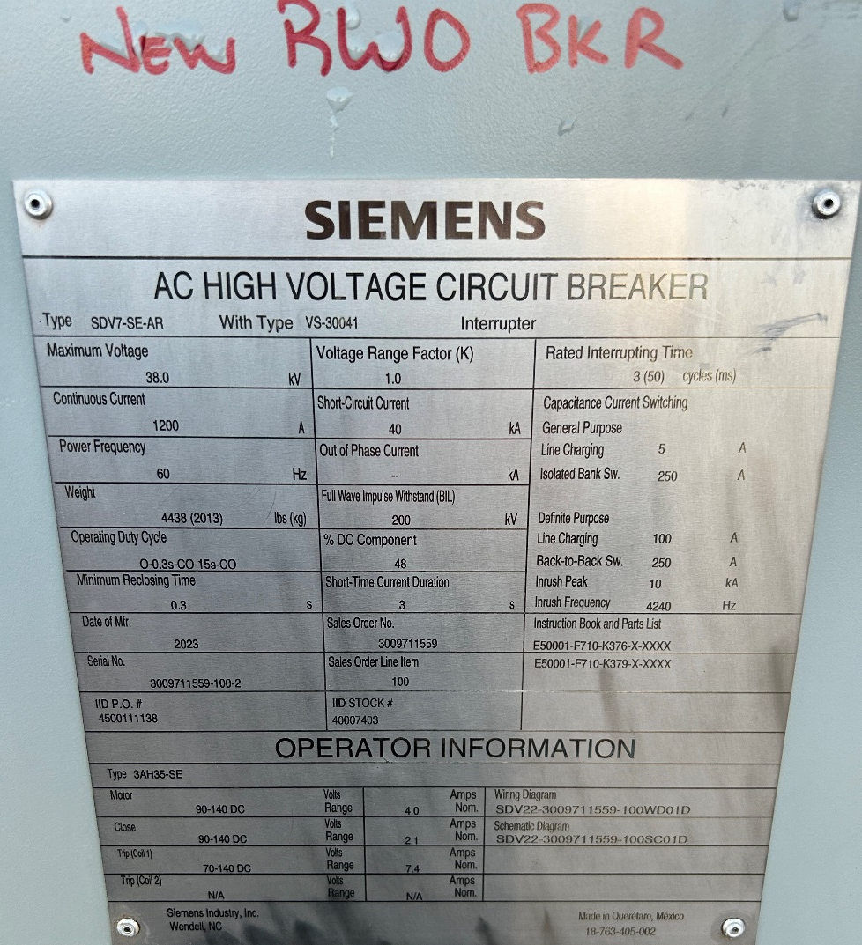
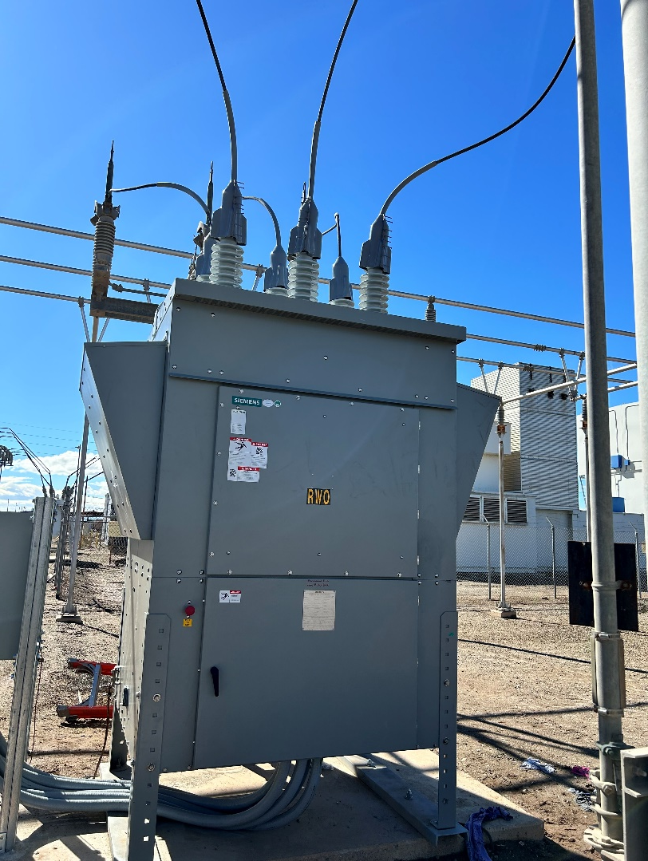
New RW-line Breaker

Slide 6
Next Steps
The IID Power Department is conducting assessments of the "Westmorland loop in". These assessments compare the reliability impact of this project with other reliability initiatives in IID's service area.
Latest estimates suggest that implementing a fully looped Westmorland substation would cost approximately half a million dollars.

